Slide 1
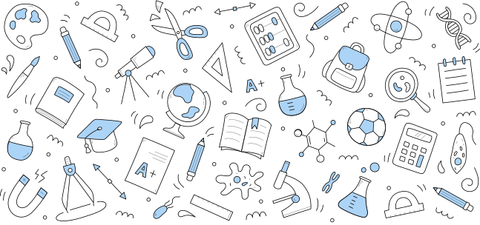
ASSIGNMENT PRESENTATION
Presented by Mahi Mudgal

Slide 2
Retrieval-Augmented Generation (RAG)
RAG combines two components:
Retriever: Finds relevant data from a knowledge base or database based on the input prompt.
Generator: Generates the output based on retrieved information and the input prompt.
In reduces hallocinations of llm models and give more personalized and accurate results.
In this healthcare use case, the retriever fetches the patient's existing records, and the generator updates the patient's history based on the prompt.

Slide 3

Solution approach
Workflow
User Prompt ➔ Generator ➔ Database ➔ Retriever ➔ Output
User inputs a natural language query (e.g., "Find all patients with mild fever").
Gemini Pro converts the query into an SQL statement using a structured prompt.
The SQL query is executed on the SQLite database.
Results or update confirmations are displayed in the Streamlit app.

Slide 4
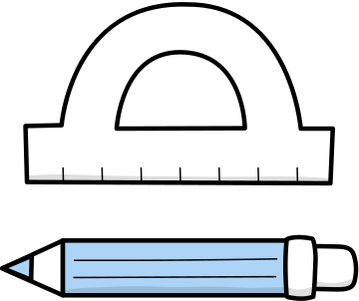
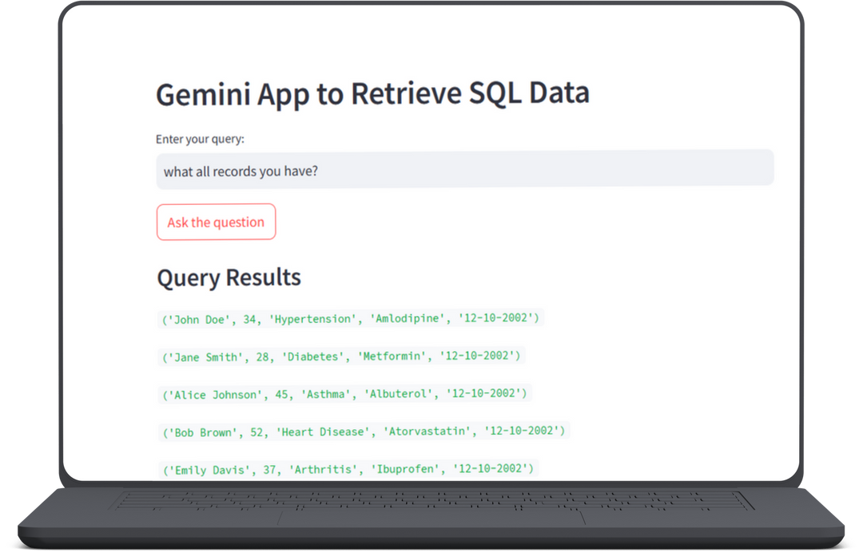

MOCKUPS
In the above mockup when a user asked to see all records and click submit.
Generator generate sql query from given prompt. And retriever retrives the record.

Slide 5
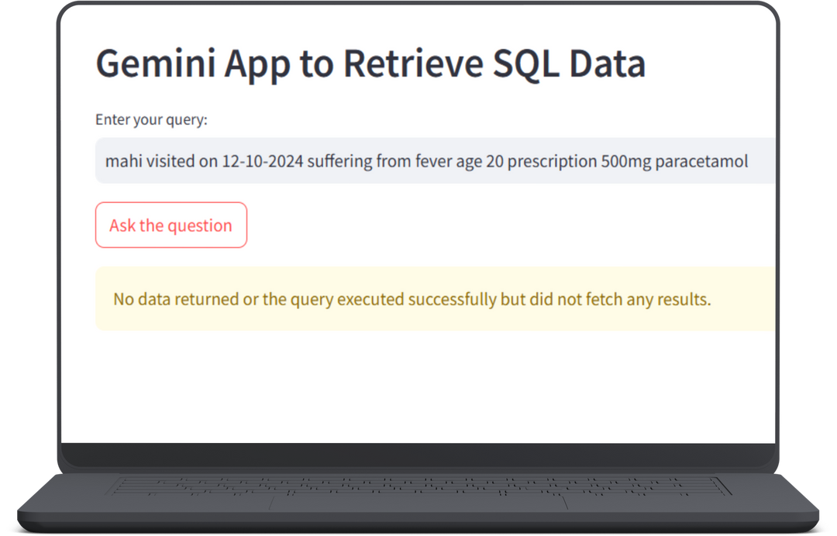
MOCKUPS
When a user updates any record then through generator an insert query generated that Insert the record in the database.
User can see the updated record statement.

Slide 6
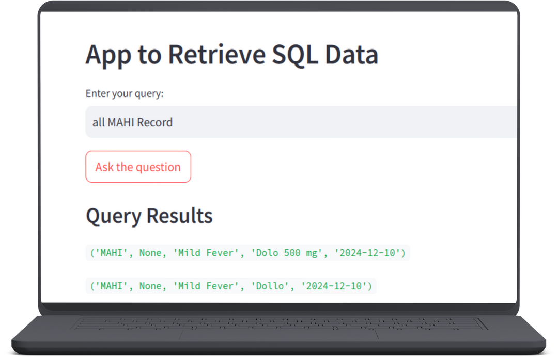
MOCKUPS
When user asked about particular name all records with same name visible on screen.

Slide 7
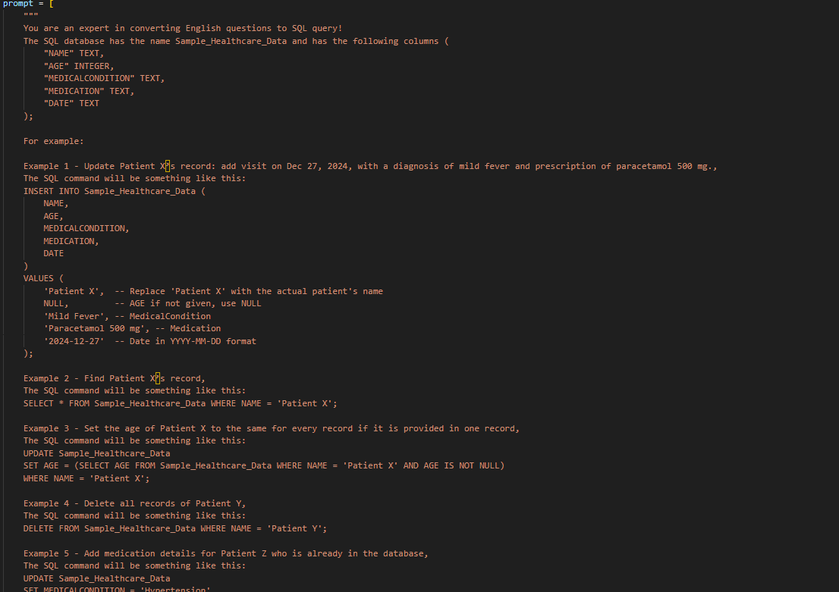
CODE SNIPPETS

Slide 8



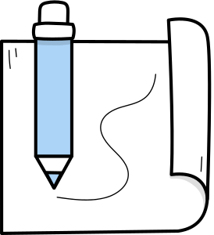
DIAGRAM
Output
Retriever
Database
Generator
User Prompt

Slide 9


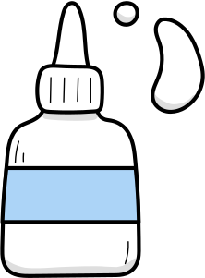
Challenges
Can’t provide multiple Query at once
Case sensitive.
Benifits
Non tech staff too can ask query.
Data base can be updated properly.
Bot query and update only particular hospital data ,where it is using.

Slide 10
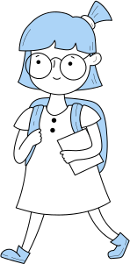
Thank You!

